Slide 1

Case Study
Cyclistic bike-share analysis

Slide 2






Content
1.
Business Model
2.
Business Task
3.
Data Model
4.
Measurement
5.
Visualization
6.
ADVISE

Slide 3
Business Model

Slide 4
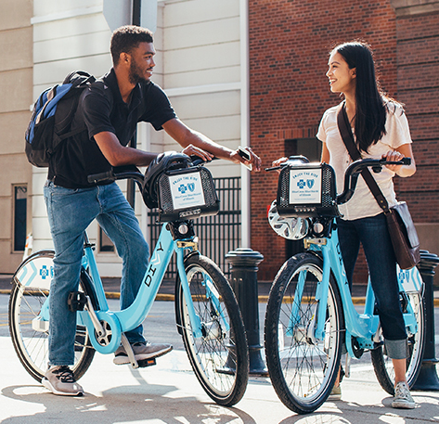
Cyclistic
Location: Chicago
Assets: 5,824 bicycles
Stations: 692
Customer group:
casual
Annual

Slide 5
Business task

Slide 6



Business Task
1. Characteristics on annual & casual rider
2. Why casual would buy annual membership
3. How digital media can affect decision making in task 2.

Slide 7
Data model

Slide 8
Step

Slide 9
Phase 1
EXCEL → ride_length, weekday
Merge & store in database
Phase 2:
SQL cleaning (split tables & fill null values in station_name, id)
Python merge & cleaning (remove not meaningful ride_length value, add time_slot columns and grouping ride_length)
Phase 3:
Preview difference in characteristics on casual and members

Slide 10
Phase 4:
Visualization by POWER BI
Analysis
Phase 5:
Recommendation

Slide 11
RECORD ON OPERATION

Slide 12
DATA CLEANING
1. ride_length
If end_time > start_at_time: obtain
Unify length 8
0:00:00 to 00:00:00 → shown in mins
2. day_of_week
If start_at_time is not null: obtain

Slide 13
Action: Fill values By SQL
3. Null values from station_name, station_id (8 CASE)
--CASE 1 (null start_station_id): 236 cases
--CASE 2 (null start_station_name): 1
--CASE 3 (null end_station_id): 117
--CASE 5 (null start_station_id and null end_station_id) : 23
Divide into FIVE SEPARATE TABLE
FOUR null table
ONE NOT null table
TWO reference tables
sharing_bike_dataset_start_station
sharing_bike_dataset_end_station

Slide 14
Solution (In Python)
1. Remove ride_length rows that is smaller than 5 mins (uneffective count)
2. Add started_time_slot and ended_time_slot column to store time_slot in hour

Slide 15
Solution (In SQL)
3. Grouping ride_length into more meaningful way (this part do in SQL)
Not in python as too slow

Slide 16
Measurement

Slide 17
1. Distribution of customer (% of casual, % of member) in a year/ month/ weekday/ per hour…
2. Sum of ride_id per year/ month/ weekday/ per hour…
3. Top 5 start_station
4. Top 5 end_station
5. Top 5 travel choice (start & end station)

Slide 18
Frequency on start_time_slot & end_time_slot
06
Distribution on ride_length in groups
07
Location of customer distribution (casual, member) in a year/ month/ weekday/ per hour…
08
popularity of bicycles for casual and member
09

